Slide 1

6th Grade Accelerated Math
Unit 4, Lesson 1 Plotting Integers Using One-Unit Scales for Axes Volume 1, pg. 131

Slide 2


Benchmark
MA.6.GR.1.1
Extend previous understanding of the coordinate plane to plot rational number ordered pairs in all four quadrants and on both axes. Identify the 𝑥- or 𝑦-axis as the line of reflection when two ordered pairs have an opposite 𝑥- and 𝑦-coordinate.
volume 1, pg. 131

Slide 3
MA.K12.MTR.1.1 Actively participate in effortful learning both individually and collectively. MA.K12.MTR.4.1 Engage in discussions that reflect on the mathematical thinking of self and others. MA.K12.MTR.5.1 Use patterns and structure to help understand and connect mathematical concepts.
Integrated Mathematical Thinking and Reasoning Standards
volume 1, pg. 131

Slide 4

Learning Target
I can plot with integers using one-unit scales for axes.
volume 1, pg. 131

Slide 5

Warm-Up
volume 1, pg. 131

Slide 6

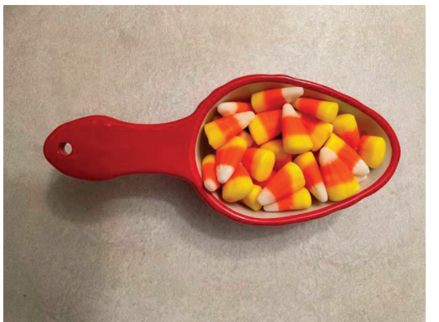
4.1.1 Warm-Up: Guess the Number
An image of ¼ cup of candy corn is shown.
1. Estimate the number of pieces of candy corn that are in the measuring cup.
volume 1, pg. 131

Slide 7
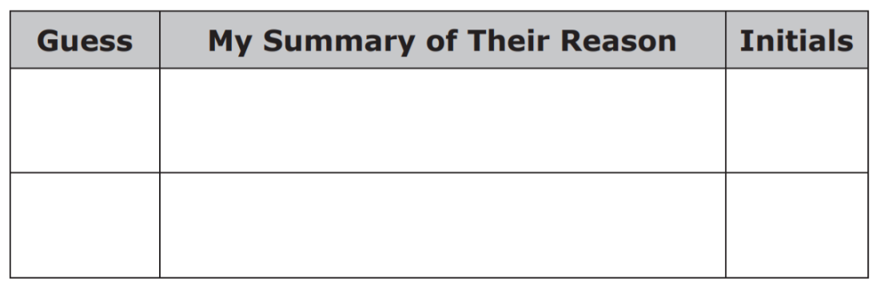
2. Ask two classmates the value they estimated. Record their value and write your summary of their reason. You are the only person who should write in the first two columns of the table. Have the person initial next to your summary stating that your summary is correct.
3. How close was your estimate to the actual number?
volume 1, pg. 131

Slide 8

Exploration
volume 1, pg. 132

Slide 9

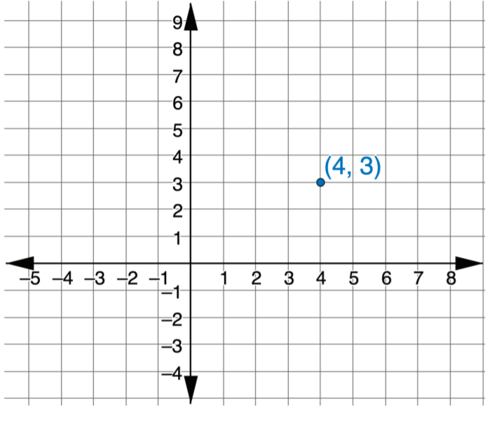
4.1.2 Exploration: The Coordinate Plane
This graph shows a point that is plotted on a coordinate plane.
The two numbers are called the coordinates. The two
numbers are also known as an ordered pair, (𝑥,𝑦).
volume 1, pg. 132

Slide 10
Discuss with your partner which coordinate will change if the point is dragged from left to right.
Discuss with your partner which coordinate will change if the point is dragged up or down.
If the point (4,3) could be dragged around on the
coordinate grid, what changes would you expect to
see in the ordered pair? Select all that apply.
□ The 𝑥-coordinate becomes smaller when the
point is moved to the left.
□ The 𝑥-coordinate becomes larger when the
point is moved to the left.
□ The 𝑥-coordinate stays the same when the point
is moved to the left.
□ The 𝑦-coordinate becomes smaller when the
point is moved up.
□ The 𝑦-coordinate becomes smaller when the
point is moved down.
□ The 𝑦-coordinate stays the same when the point is moved up.
volume 1, pg. 132

Slide 11
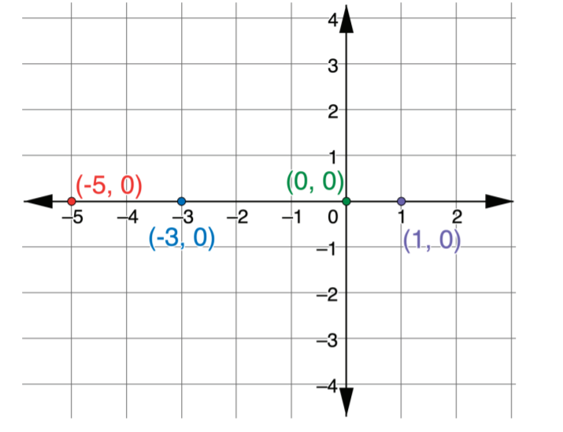
2. Four points are plotted on the coordinate grid.
What do you notice about all four points?
What is the same about the points?
What is different about the points?
Discuss with your partner what is true about all the
points on the 𝑥-axis.
volume 1, pg. 132

Slide 12
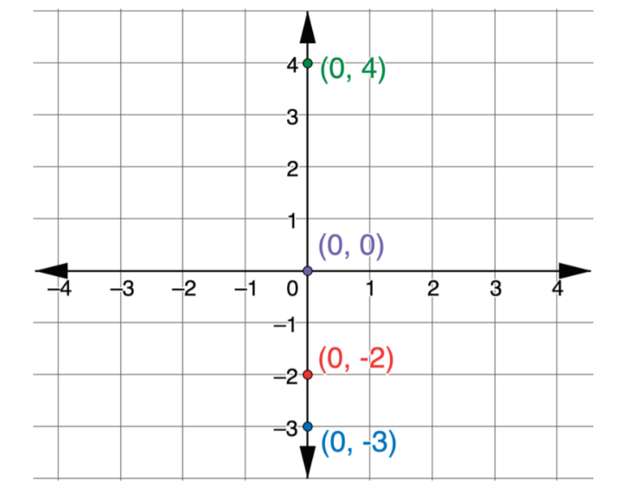
3. Four points are plotted on the coordinate grid.
What is the same about the points?
b. What is different about the points?
volume 1, pg. 133

Slide 13
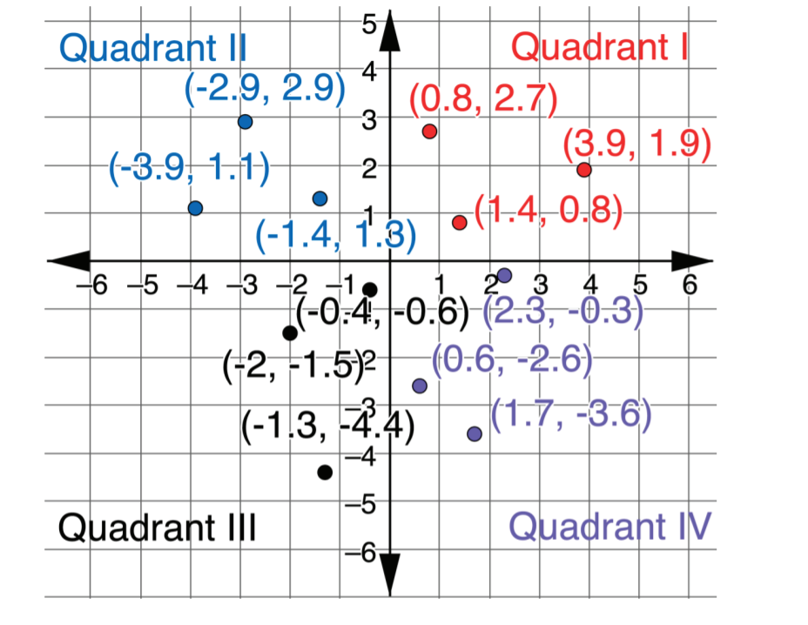
4. Twelve points are plotted on the coordinate grid. The grid shows the labels Quadrant I, Quadrant II, Quadrant III, and Quadrant IV.
volume 1, pg. 134

Slide 14
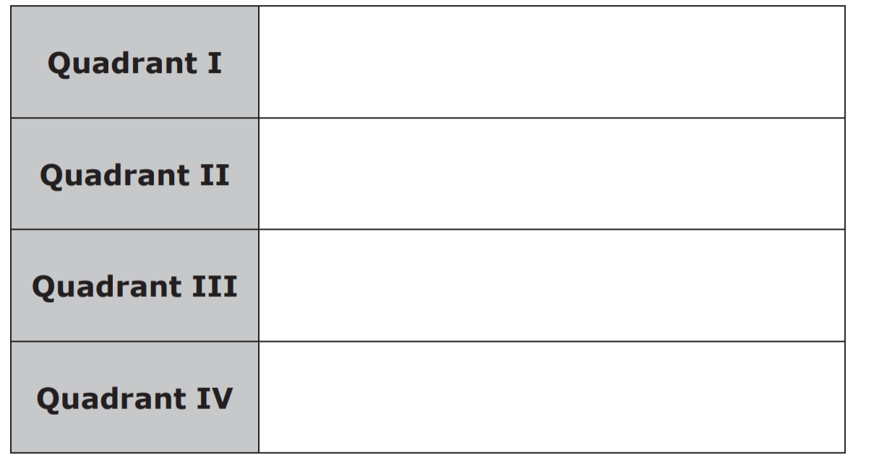
Work with your partner to summarize the characteristics of the points in each quadrant. Write your summary in the table.
volume 1, pg. 134

Slide 15

Bring It Together
volume 1, pg. 134

Slide 16

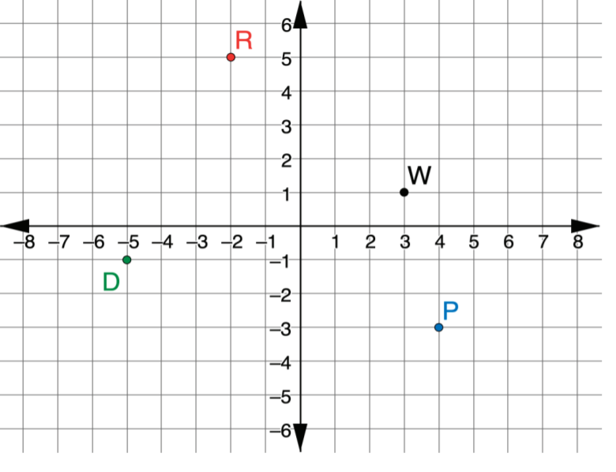
4.1.3 Bring It Together: Plotting Ordered Pairs
1. Points 𝐷, 𝑃, 𝑅, and 𝑊 are plotted on the coordinate grid.
volume 1, pg. 134

Slide 17
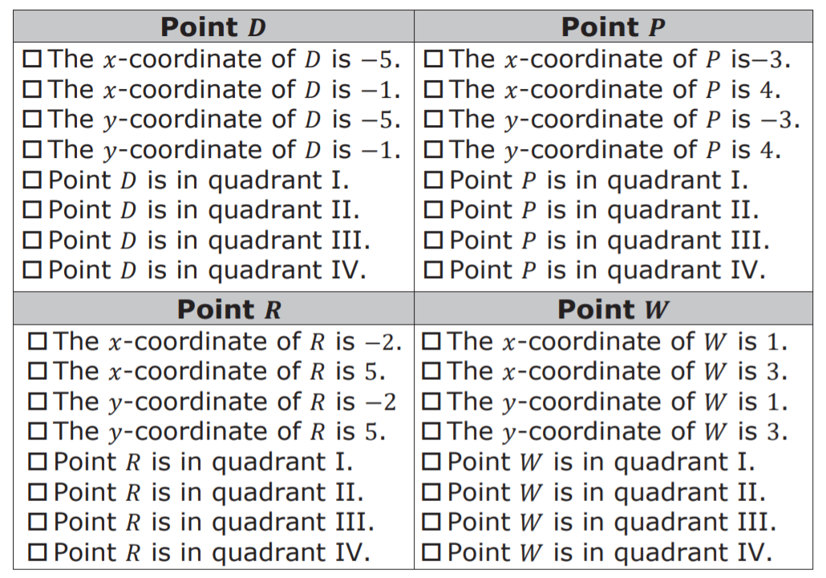
Select all of the descriptions of each point.
volume 1, pg. 134

Slide 18
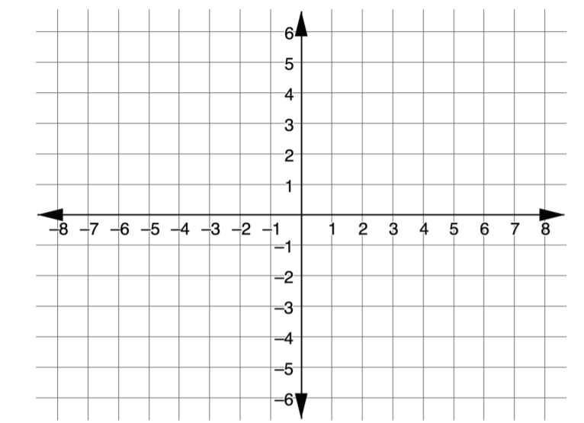
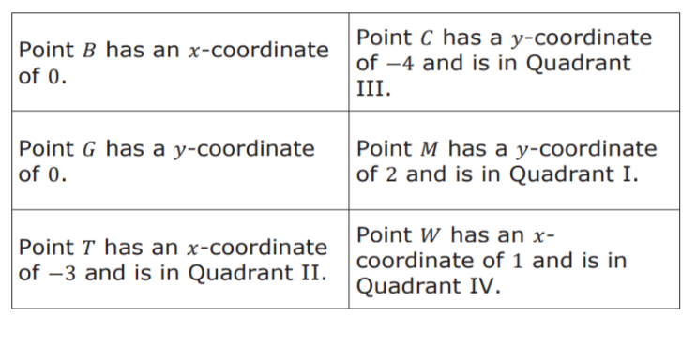
2. Use the coordinate grid to plot and label points that have the characteristics described in the table.
volume 1, pg. 135

Slide 19

Guided Instruction
volume 1, pg. 135

Slide 20
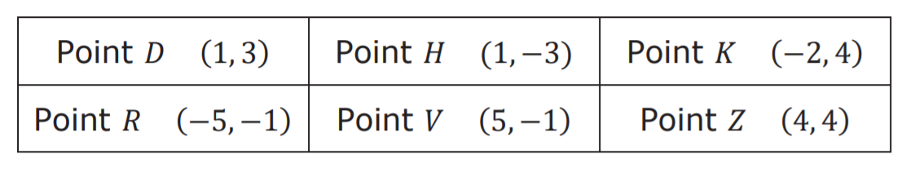
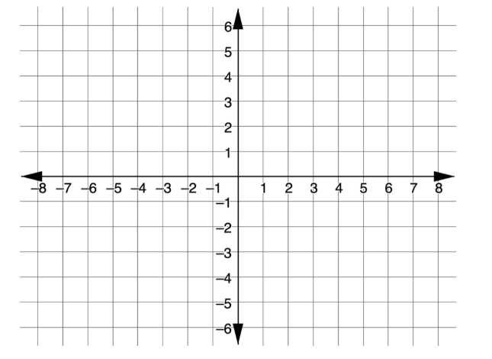
4.1.4 Guided Instruction: Reflections
Use the points in the table for the following.
a. Plot the ordered pairs from the table on the coordinate grid below. Label using the given letter.
volume 1, pg. 135

Slide 21
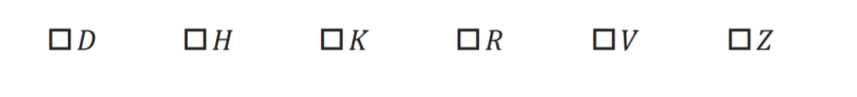
b. Select the pair of points that have the same 𝑥-coordinate.
c. Select the pair of points that have a 𝑦-coordinate of −1.
volume 1, pg. 135

Slide 22
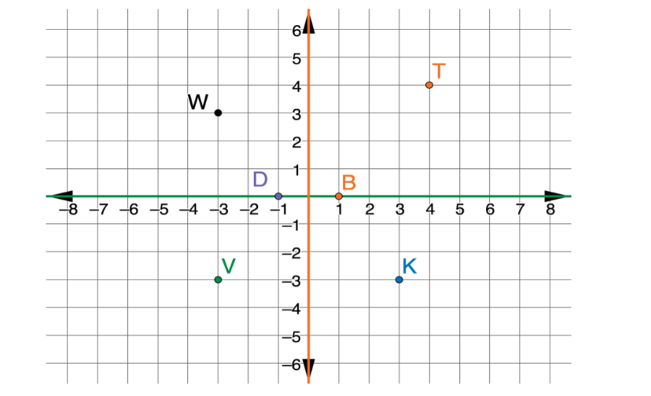
2. A coordinate grid with points 𝐷, 𝐵, 𝐾, 𝑇, 𝑉, and 𝑊 is shown. The 𝑥-axis is green and the 𝑦-axis is orange.
a. Write the ordered pair of the reflection of Point V when the graph is folded across the 𝑥-axis.
b. Write the ordered pair of the reflection of Point K when the graph is folded across the 𝑦-axis.
c. Write the ordered pair of the reflection of Point D when the graph is folded across the 𝑦-axis.
d. Write the ordered pair of the reflection of Point B when the graph is folded across the 𝑥-axis.
volume 1, pg. 136

Slide 23

Guided Practice
volume 1, pg. 136

Slide 24

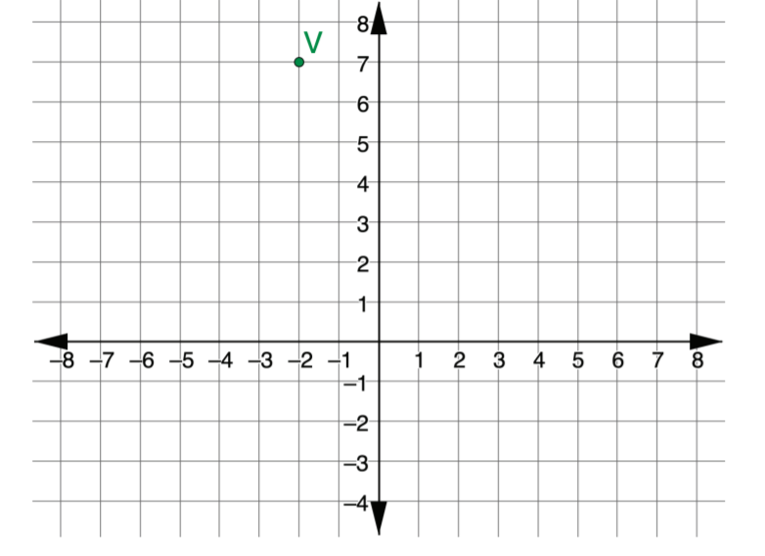
4.1.5 Guided Practice: Reflections
Point 𝑉 is plotted on the coordinate grid.
What are the coordinates of the reflection of 𝑉 across the 𝑦-axis?
volume 1, pg. 136

Slide 25
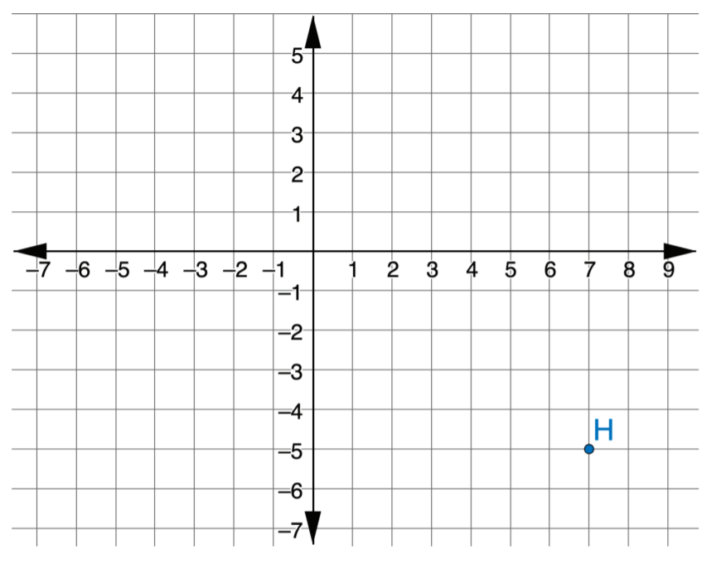
2. Point 𝐻 is plotted on the coordinate grid.
What are the coordinates of the reflection of 𝐻 across the 𝑥-axis?
volume 1, pg. 137

Slide 26

Wrap-Up
volume 1, pg. 137

Slide 27
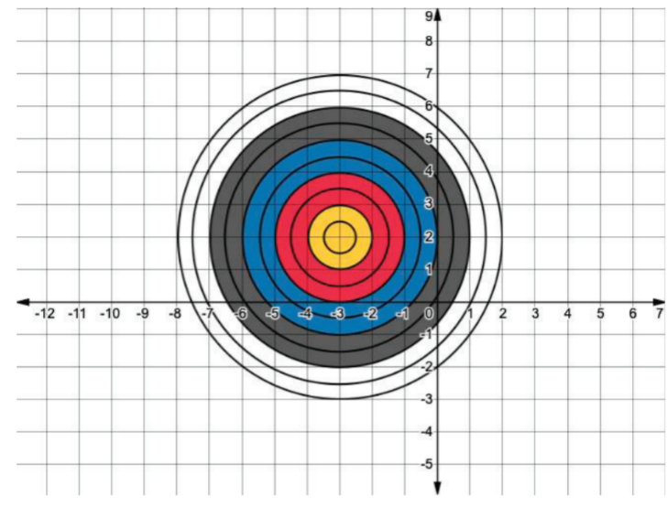
4.1.6 Wrap-Up: Ticket Out the Door
What are the coordinates of the reflection of 𝐻 across the 𝑥-axis?
1. Write the ordered pair that will hit the bullseye.
volume 1, pg. 137

Slide 28
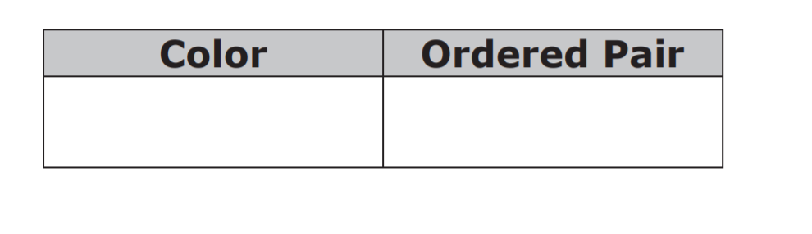
2. A player throws two darts. The first dart hits the ordered pair (−2, −1). The second dart hits the point that is the reflection of (−2, −1) over the 𝑥𝑥-axis. Complete the table that describes the location of the second dart.
volume 1, pg. 137

